Slide 1

Hanfu Tale
Yao Wu
Xue Zheng
Rubing Zhang
Chunmei Zhang
https://github.com/adinashby-vanier-college/transactional-web-project-2395035

Slide 2
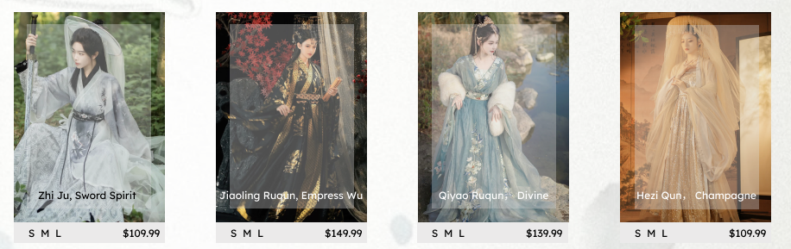
Introduction to Hanfu
Brief history and significance
Resurgence of Hanfu in modern times
Intersection of tradition and contemporary fashion

Slide 3
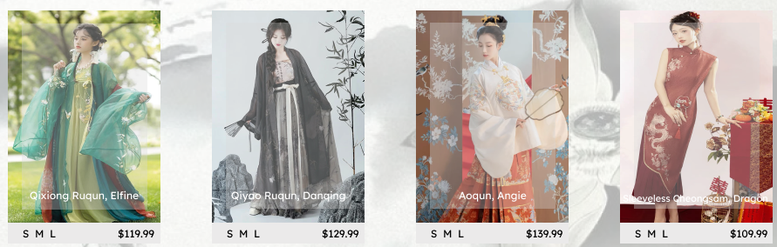
Hanfu Costume Showcase
Visual display of diverse Hanfu styles
Cultural significance of different elements
The allure of Hanfu in today's fashion landscape

Slide 4
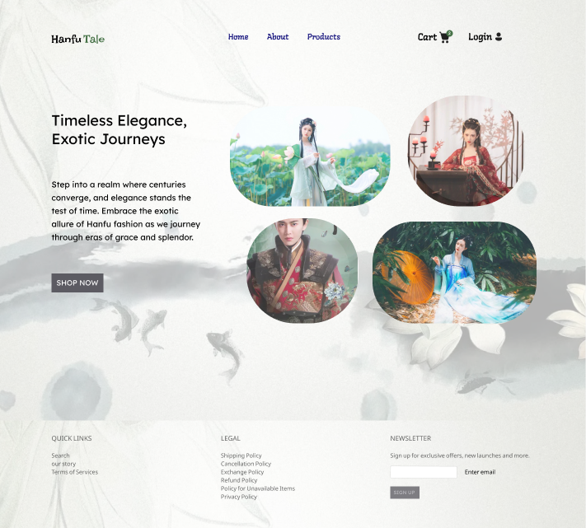
User-Friendly Interface
Seamlessly Navigate Tradition
Intuitive design for effortless exploration.
Responsive interface for a seamless user experience.
User-friendly features to enhance accessibility and engagement.

Slide 5
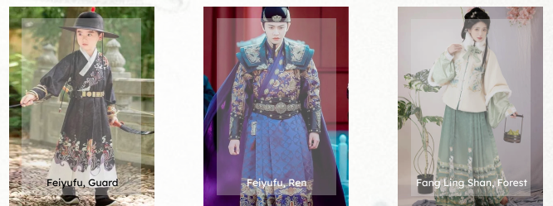
Advanced Filtering and Sorting
Tailoring Choices to Your Preferences
Advanced filtering options for users to refine their search.
Sorting features based on historical periods, styles, and occasions.
A personalized shopping experience through tailored preferences.

Slide 6
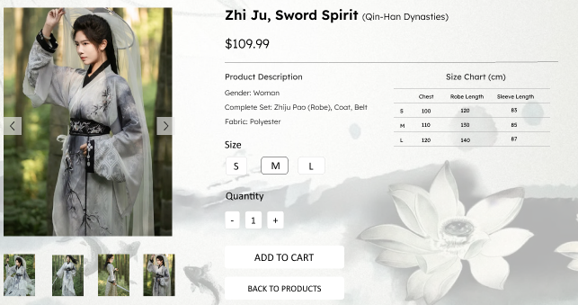
Shopping Cart Integration
Your Cart, Your Tradition
Seamless integration of shopping cart functionality.
Save and review selected items.
Streamlined checkout process for a hassle-free shopping experience.

Slide 7
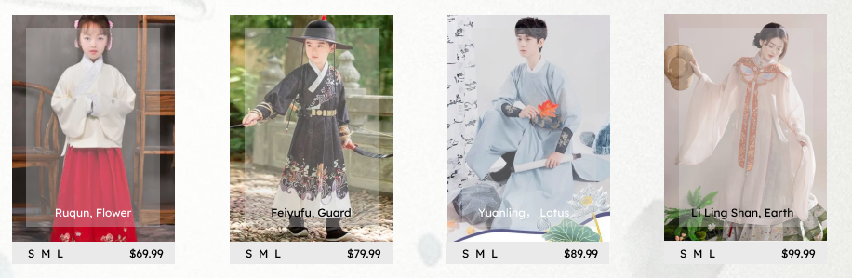
User Accounts and Privileges
Personalized Traditions
User account creation for a personalized experience.
Privileges for registered users, such as exclusive discounts and early access.
Enhanced security features for user data protection.

Slide 8
Database Management with MongoDB
Crafting a Robust Foundation
Utilization of MongoDB for efficient and scalable database management.
High-performance data storage for seamless user interactions.
Enhanced reliability and flexibility in handling Hanfu product information.

Slide 9
Full Stack Technology
Powering Tradition with Technology
Frontend: React for a dynamic and responsive user interface.
Backend: JavaScript (Node.js) for server-side logic and functionality.
Database: MongoDB for efficient data storage and retrieval.

Slide 10
Cloud Services: AWS
Elevating Tradition to the Cloud
Utilization of Amazon Web Services (AWS) for scalable and reliable cloud infrastructure.
Benefits of cloud services in ensuring optimal performance and accessibility.
Seamless integration with AWS for enhanced efficiency.

Slide 11
Deployment and Testing: CI/CD
Ensuring a Smooth Journey
Continuous Integration (CI) and Continuous Deployment (CD) for automated and reliable processes.
Streamlined deployment pipelines for quick and efficient updates.
Rigorous testing procedures to guarantee a stable and secure platform.

Slide 12
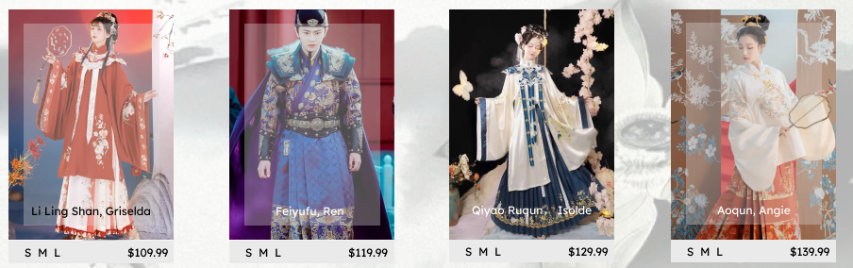
Conclusion
Bridging Tradition and Technology
Recap of the key features and technologies discussed.
Inviting users to embark on a cultural journey through our user-friendly platform.
Encouraging engagement and feedback for continuous improvement.

